Slide 1
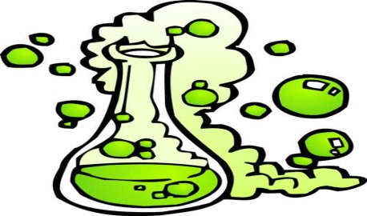
CHEMICAL REACTIONS
This is when one chemical reacts with another chemical to produce totally different forms of these chemicals.
We have seen that if you take a gas called Hydrogen (H) and react it with a gas called Chlorine (Cl), they join to form a brand new liquid called HydroChloric Acid (HCl), or Hydrogen Chloride. This is all shown by:
H + Cl → HCl
Everything on the left of the arrow is a reactant.
Everything on the right of the arrow is a product.

Slide 2
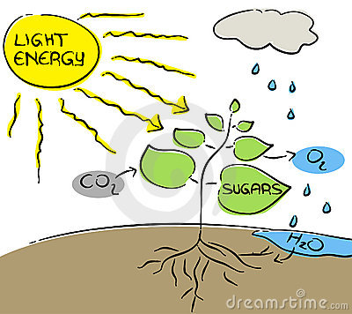
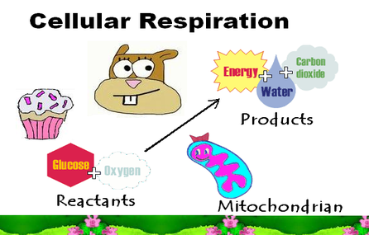
Our example to make HCl is a synthesis reaction. But the same rule holds for a decomposition reaction. NaOH → Na + O + H
Everything to the left of the arrow is the reactant.
Everything to the right of the arrow is the product.
SO: Every Chemical Reaction is shown by:
REACTANTS → PRODUCTS
Chemical reactions are happening around us all the time. Like PhotoSynthesis. And Respiration. And iron turning into rust. And battery acid reacting to produce electricity. All part of life around us.

Slide 3
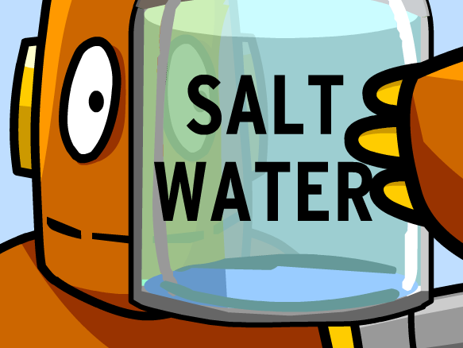
PURE (Compound)? Or MIXED?
These are scientists trying to sound smart again!
If something is made of atoms that are chemically joined together to form a compound, then that thing is pure. Like Water: 2 H atoms have chemically bonded onto one O atom.
If things are just mixed together and have not chemically joined, then it is not pure. This is called a mixture. Like in salt water: the Water (H2O) and the Salt (NaCl) are mixed together, but will stay separate – they only dissolve and will never react with each other to form a chemical bond.
See the differences between them - Table: page 23.

Slide 4
QUESTIONS Pages 81-82
Question 1
Two chemicals react together to produce a new product. [2]
Respiration. Photosynthesis. Iron rusting. Making beer, etc. [3]
Question 2
A and B [2]
C and D [2]

Slide 5
Question 3
Synthesis (Building up) and Decomposition (Breaking down) [2]
Magnesium + Oxygen → Magnesium Oxide
Sodium + Chlorine → Sodium Chloride
REACTANTS → PRODUCTS
3. Water → Hydrogen + Oxygen
Mercury Oxide → Mercury + Oxygen
Etcetera [12]

Slide 6
Question 4
Maize (Mealies), Malt, Yeast, Water. [4]
Carbon Dioxide, Alcohol. [2]
Vitamin B. [1]
Less than 3%. [1]
Question 5
Two substances are chemically joined together. [2]
Any compounds: Oxygen, Sugar, Iron, Water. [3]
Two substances not chemically joined together. [2]
(a) Iron filings and Sulfur [2]
(b) Iron filings and Water [2]
(c) Sugar and Salt [2]

Slide 7
Question 6 [8]
MIXTURES | COMPOUNDS
Not chemically joined. | Are chemically joined.
Each item keeps its own properties. | New compound has new properties.
Can be physically separated. | CanNOT be physically separated.
Any mixture is possible. | Proportions of atoms are specific.

